Slide 1
VAST CHALLENGE 2024
MINI CHALLENGE 2
MEHMET EMRE SAHIN, FUNDA YILDIZ AYDIN, SINEM BILGE GÜLER

Slide 2
DWELL
SouthSeaFood Corp Vessels

Slide 3
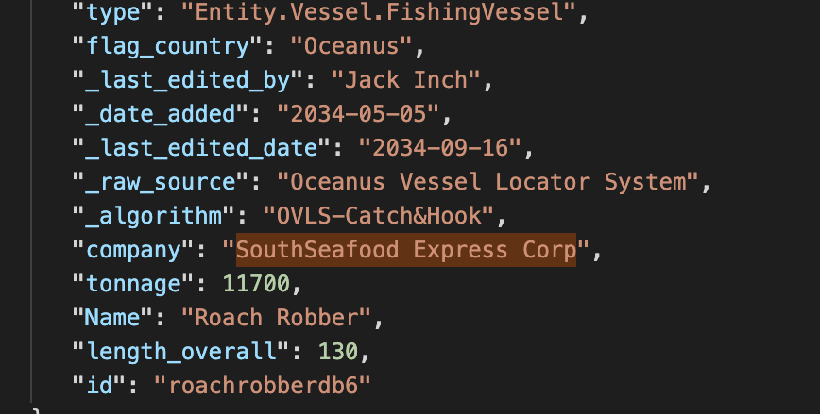
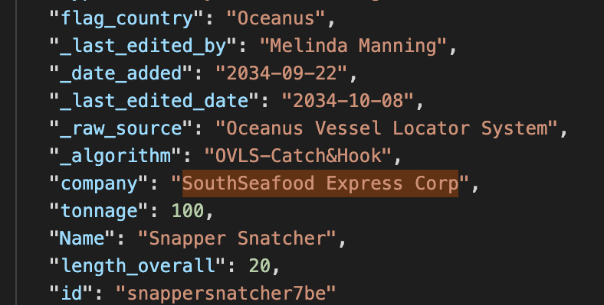
TERMS
Date Added : Logging in to the system
Last Time Edited: Logging off from the system
Time: Time started to get recorded
Dwell: Time spent (first it was in mins then got post-processed)
Oceanus (flag)
Oceanus Vessel Locator System

Slide 4
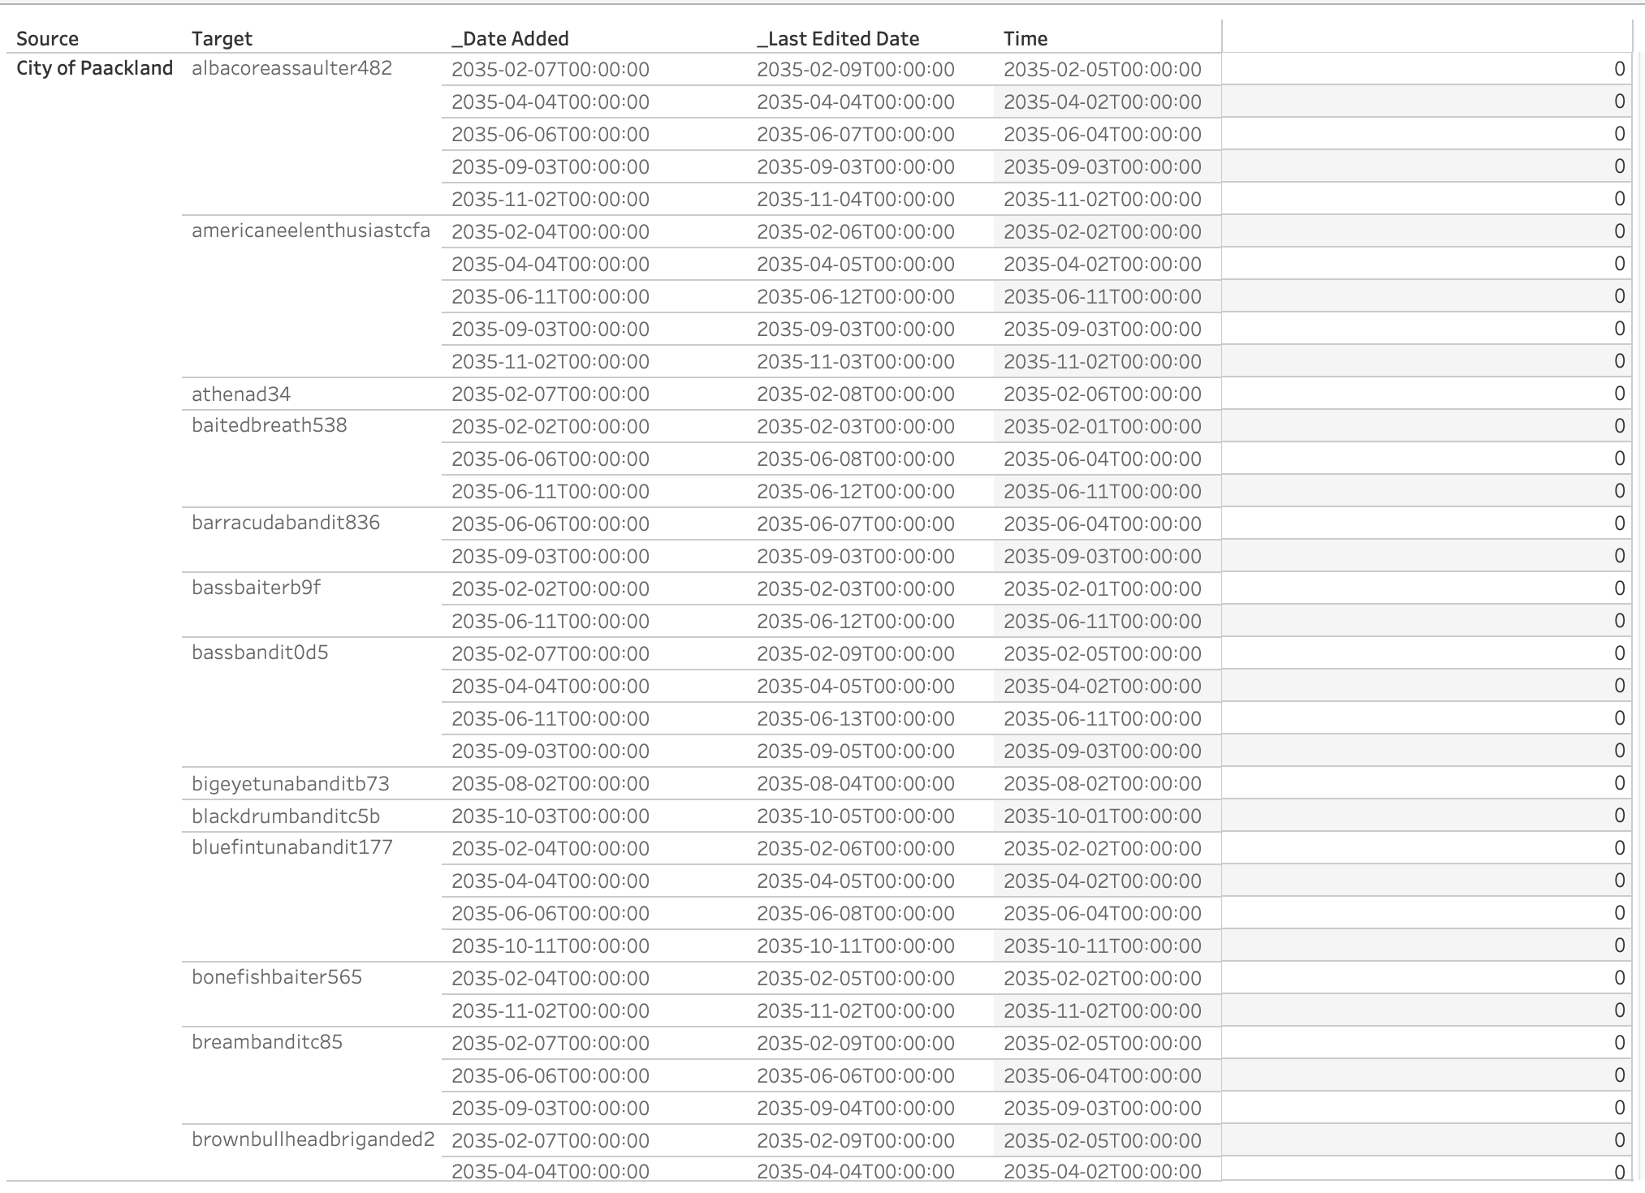
SOME FINDINGS
When the time of the dates are recorded as 00:00:00, the dwell time is 0

Slide 5
DWELL CALCULATIONS
1.122.320×60+0.424658×60=7339.2+25.47948=7364.67948seconds 7364.67948seconds÷86400=0.085248days
IN MINS =>
IN SECONDS =>
IN MILLISECONDS =>
122.320424658seconds÷86400=0.001415days
122.320424658milliseconds÷1000=0.122320424658seconds
0.122320424658seconds÷86400=0.000001416days
Some of the values have a large dwell value which exceeds the last edited date, or date added which is earlier than time however we found something else which shows a clear error…

Slide 6
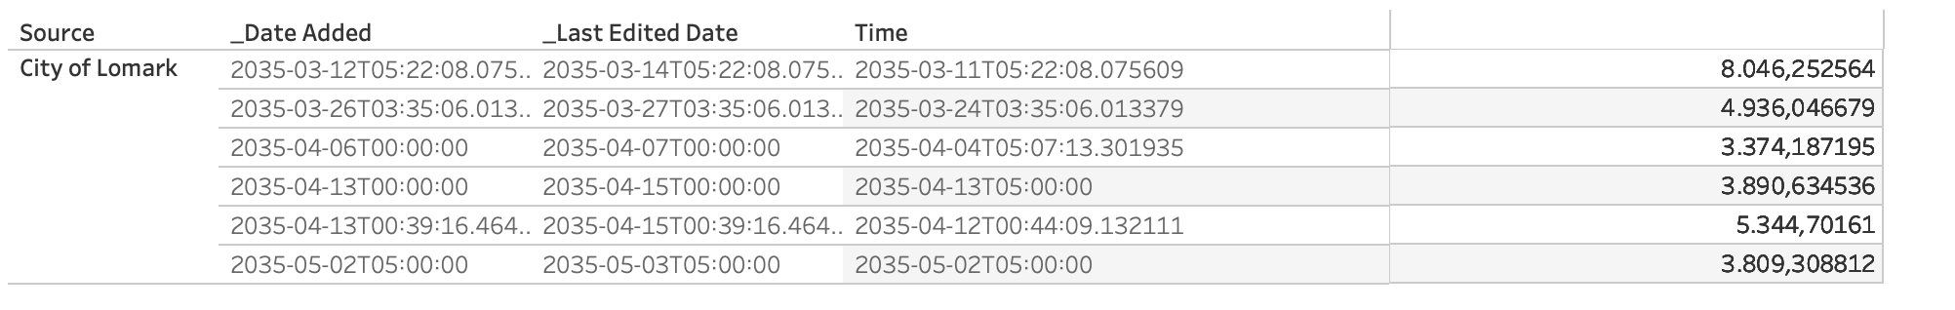
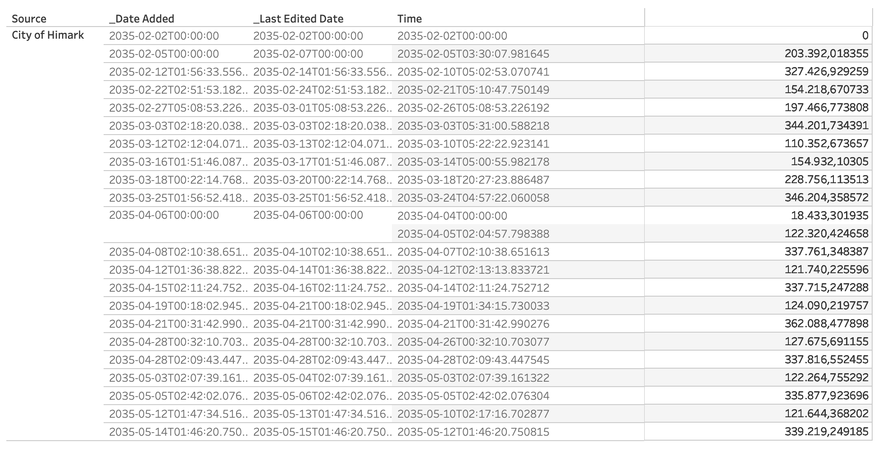
Roach Robber

Slide 7

QUESTIONS
FishEye analysts have long wanted to better understand the flow of commercially caught fish through Oceanus’s many ports. But as they were loading data into CatchNet, they discovered they had purchased the wrong port records. They wanted to get the ship off-load records, but they instead got the port-exit records (essentially trucks/trains leaving the port area). Port exit records do not include which vessel that delivered the products. Given this limitation, develop a visualization system to associate vessels with their probable cargos. Which vessels deliver which products and when? What are the seasonal trends and anomalies in the port exit records?
Develop visualizations that illustrate the inappropriate behavior of SouthSeafood Express Corp vessels. How do their movement and catch contents compare to other fishing vessels? When and where did SouthSeafood Express Corp vessels perform their illegal fishing? How many different types of suspicious behaviors are observed? Use visual evidence to justify your conclusions.
To support further Fisheye investigations, develop visual analytics workflows that allow you to discover other vessels engaging in behaviors similar to SouthSeafood Express Corp’s illegal activities? Provide visual evidence of the similarities.
How did fishing activity change after SouthSeafood Express Corp was caught? What new behaviors in the Oceanus commercial fishing community are most suspicious and why?

Slide 8
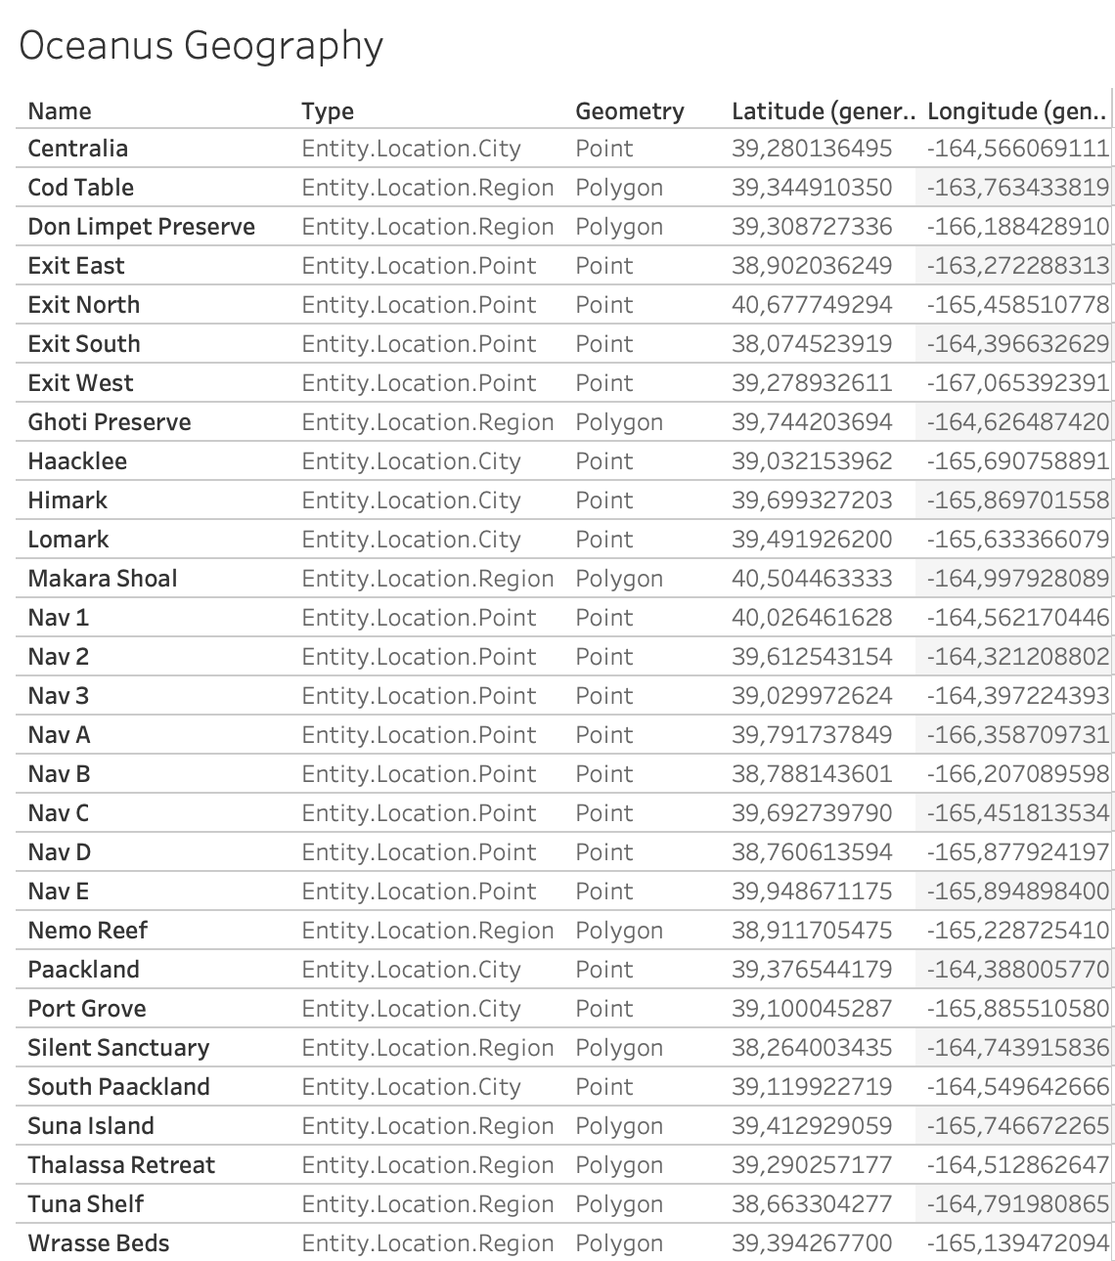
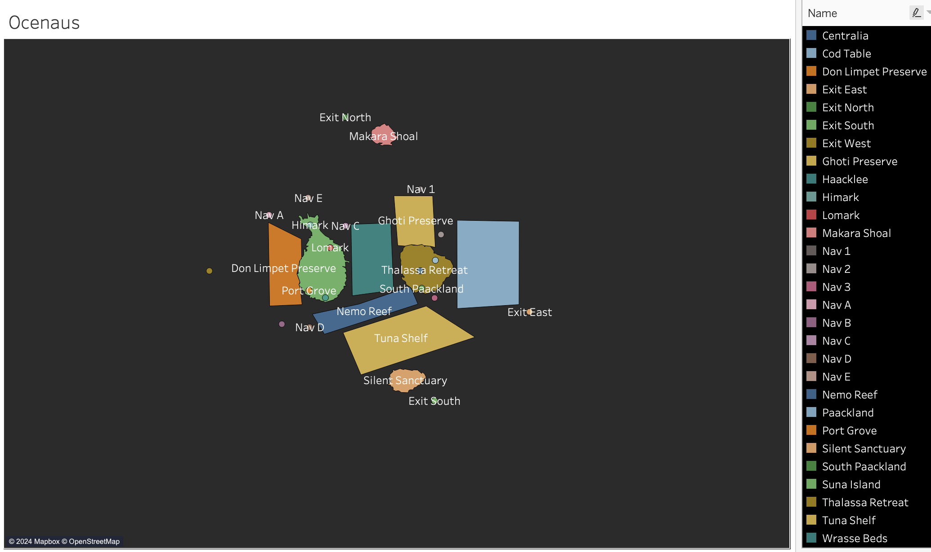
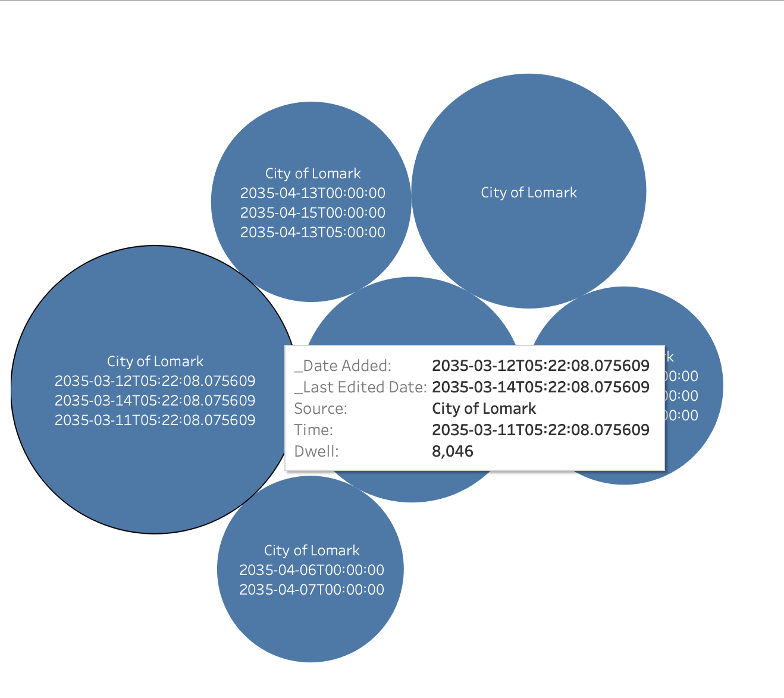
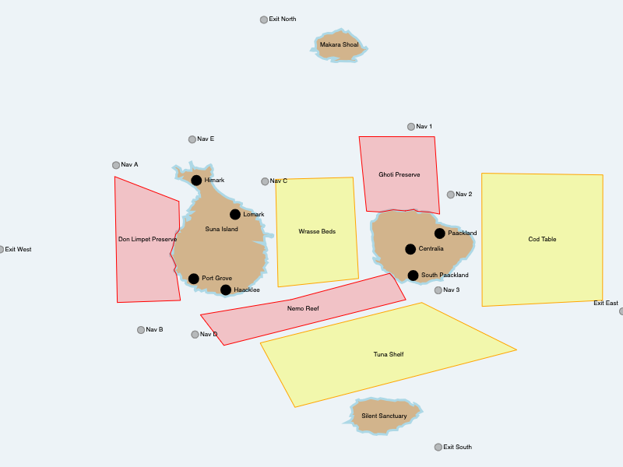
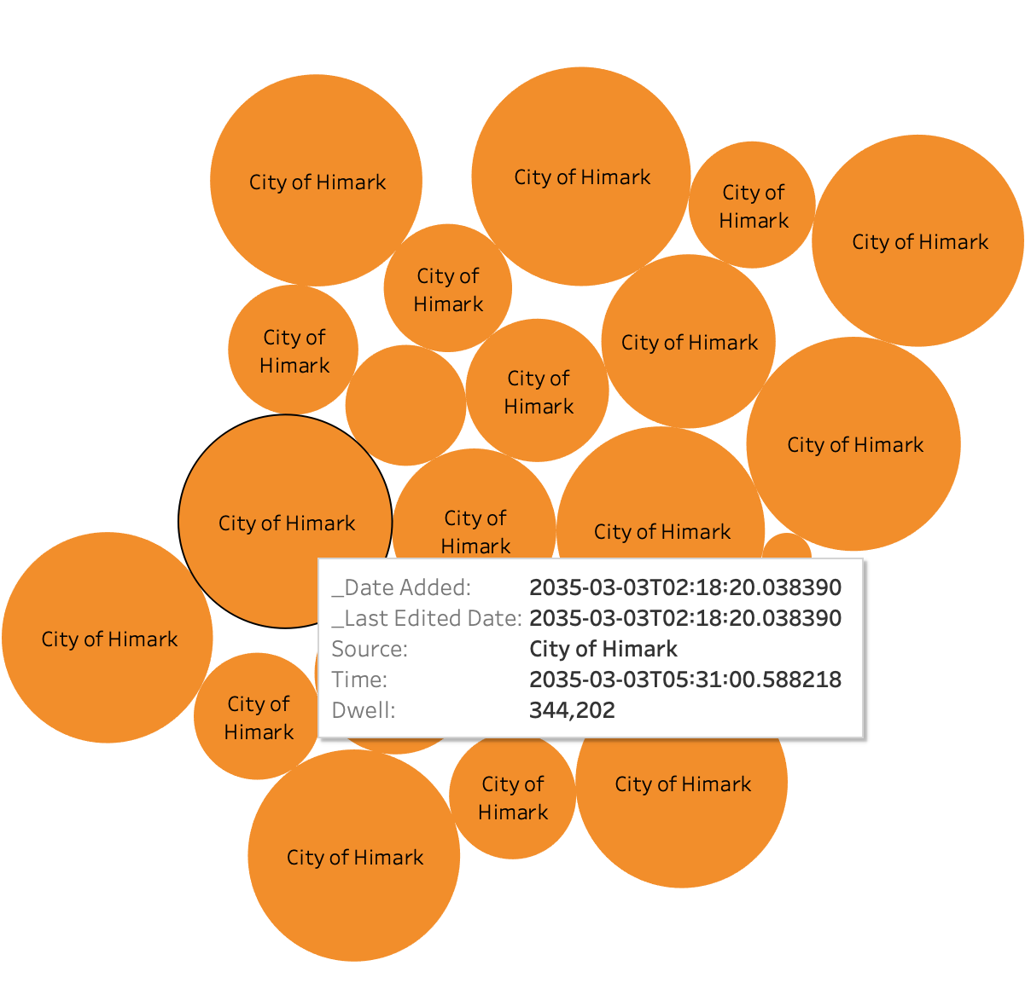

Slide 9
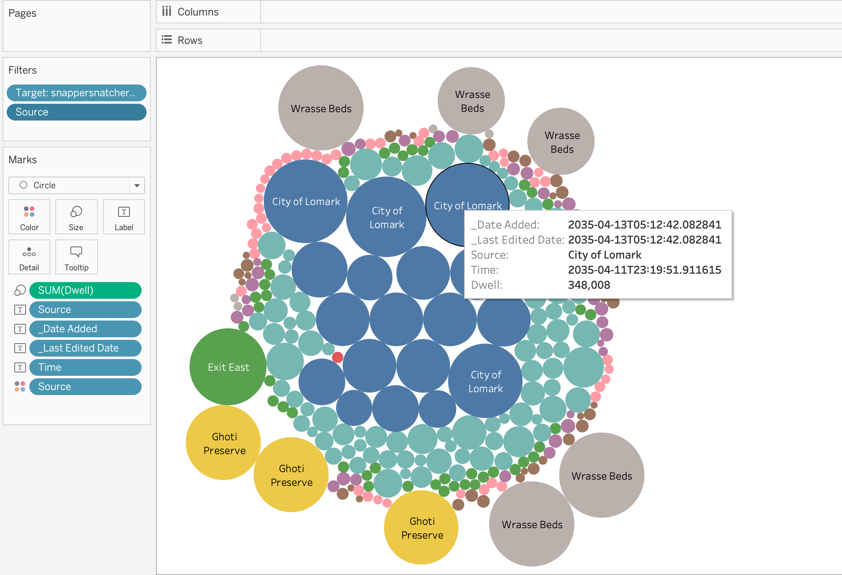
SNAPPER SNATCHER

Slide 10
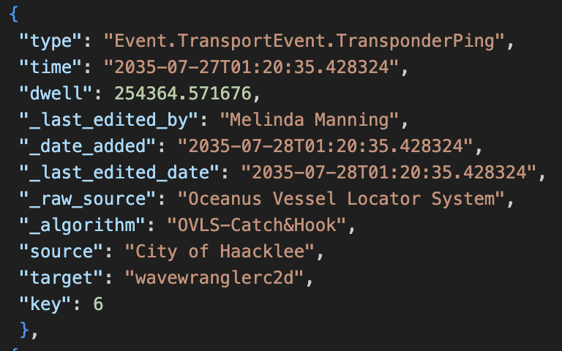
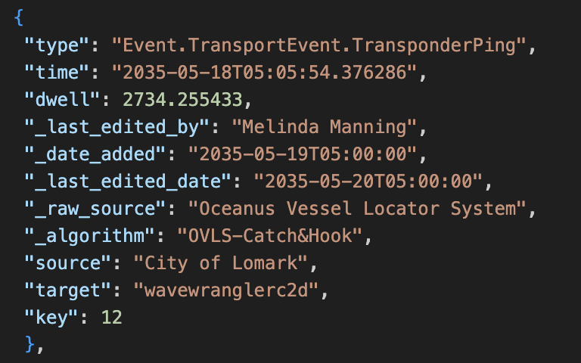
Regarding the mini challenge-2 question “How did fishing activity change after SouthSeafood Express Corp was caught? What new behaviors in the Oceanus commercial fishing community are most suspicious and why?”
Once we try to make a relationship between dwell duration and time and the last edited date duration gap, dwell duration does not make sense regarding between those time gaps.

Slide 11
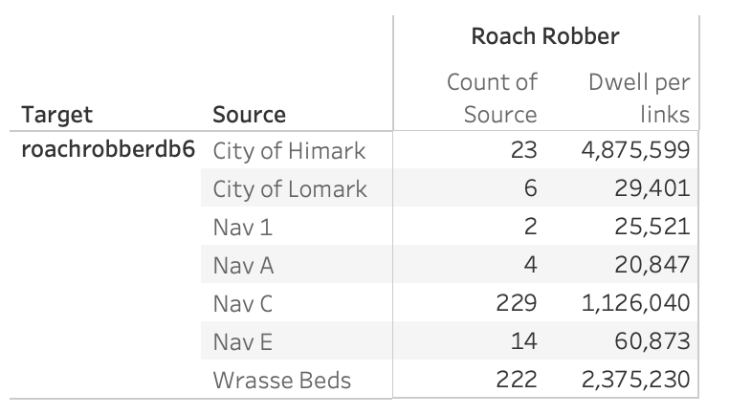
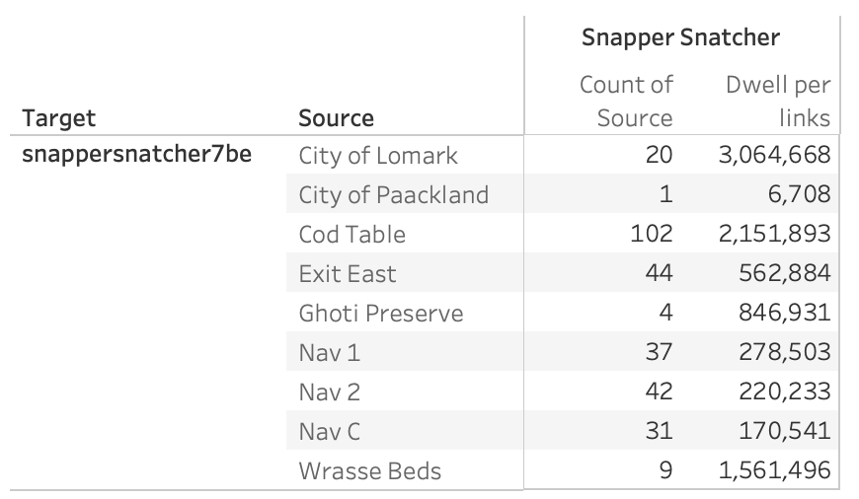
South Seafood Corp Express’ Fishing Vessels

Slide 12
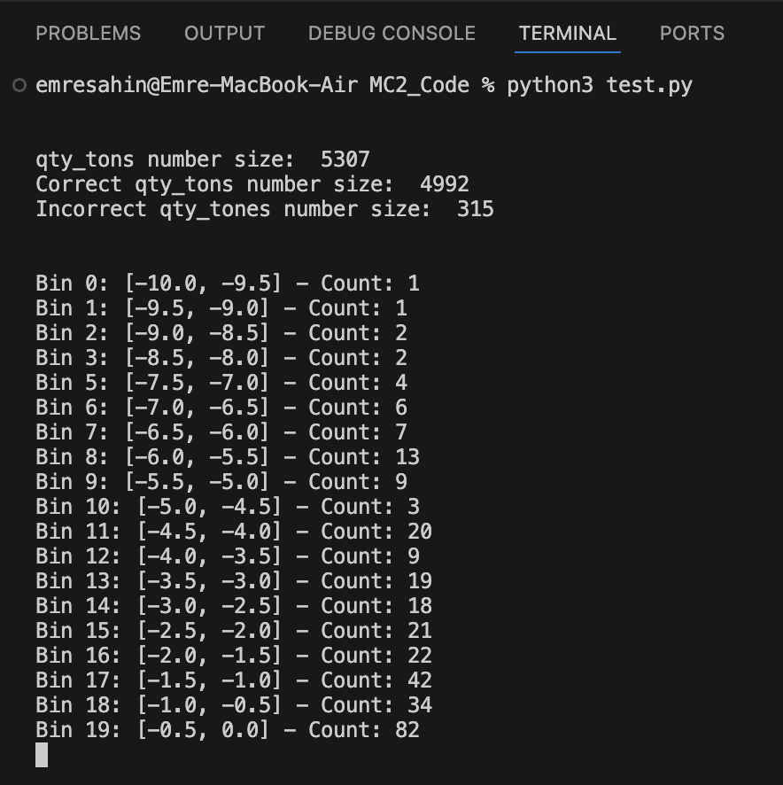
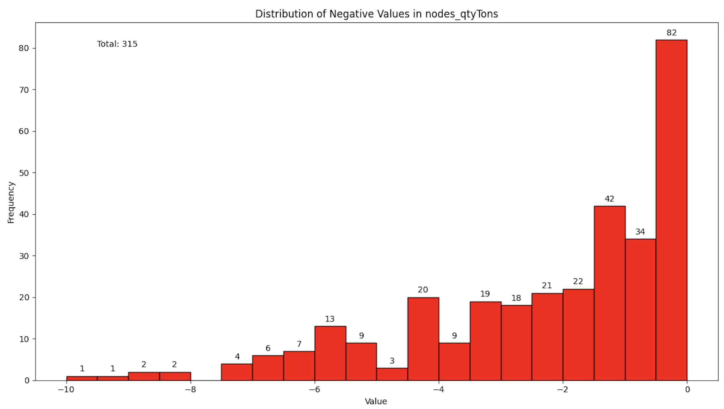
The graph regarding qty_tons numbers that are smaller than or equal to zero.

Slide 13
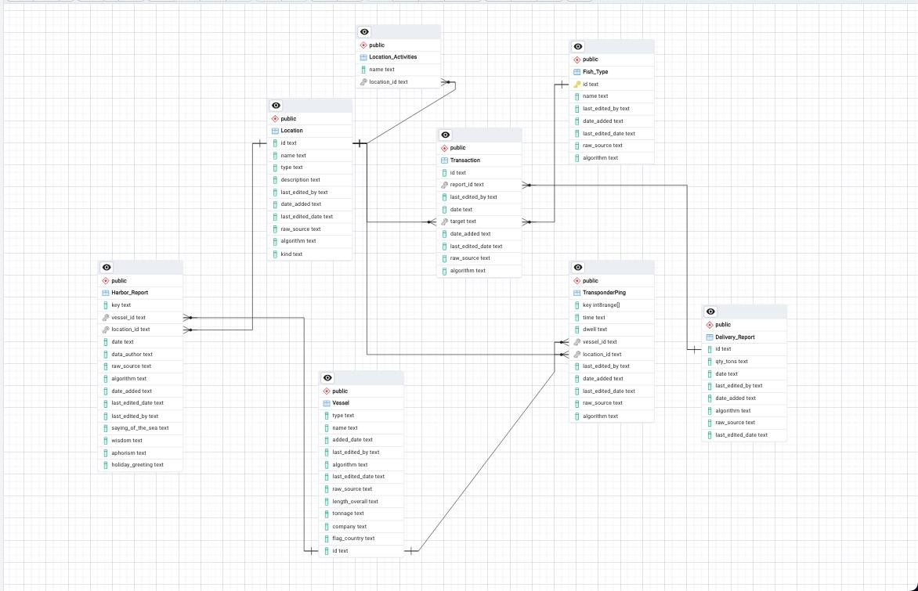

Slide 14
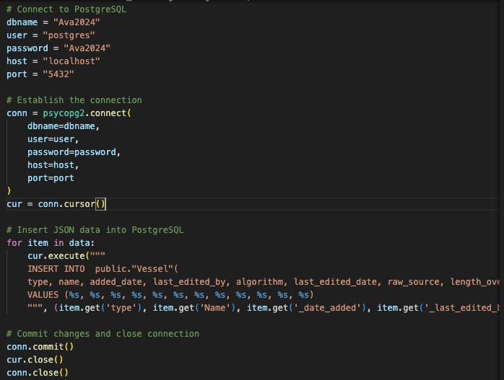
-Connecting to database
-Inserting Entity.Vessel to Vessel table

Slide 15
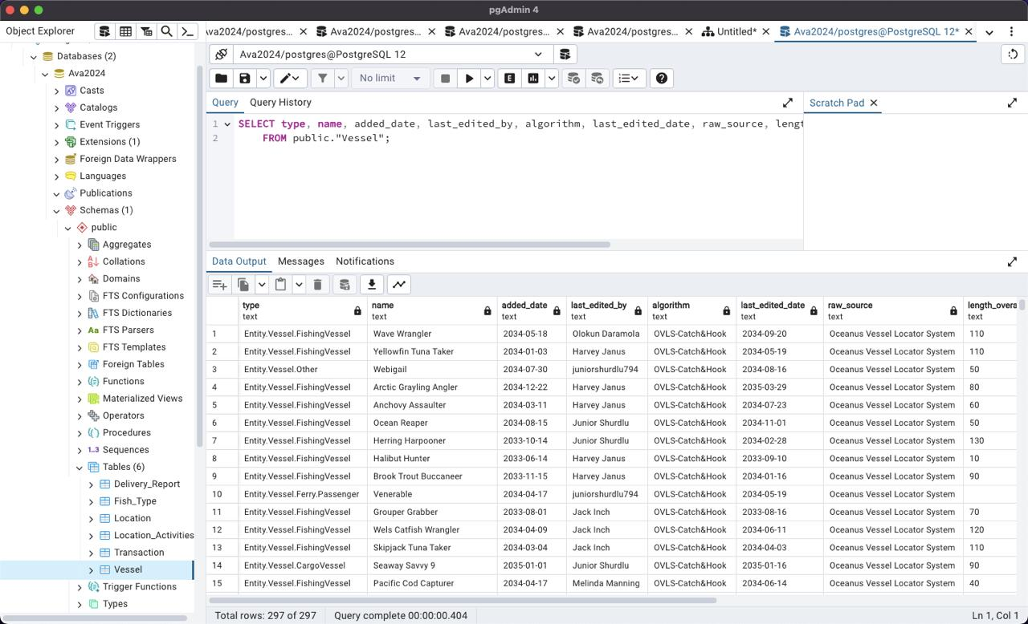

Slide 16
Thank you for listening us

